Slide 1
Course Project
Operating Systems
Module 5 Network Configuration

Slide 2
Rubric
Activity | Requirement(s) | Points
Discover host IP configurations | Answer four questions Take a screenshot | 20
Manage network interfaces | Answer two questions | 20
User network utilities | Take a screenshot | 20

Slide 3
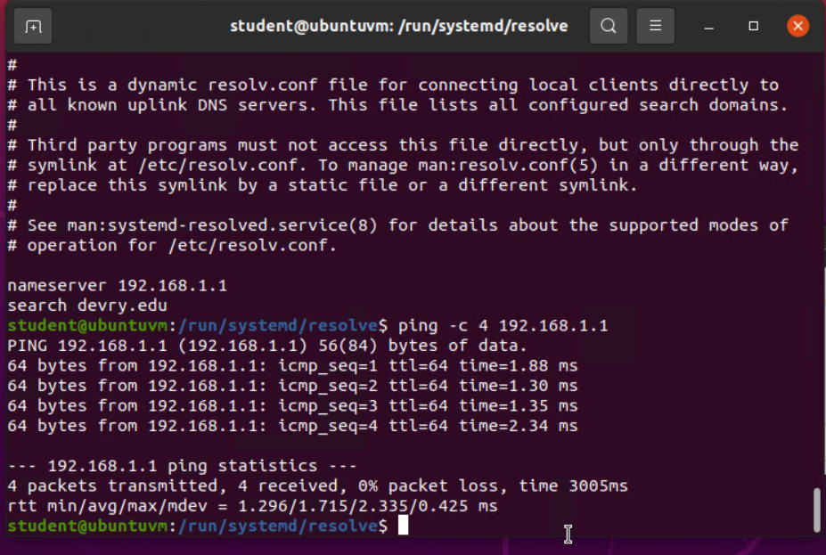
Discover host IP configurations
1. What is the IP address of your Ubuntu machine?
Answer here: 192.168.1.104
2. What is the IP address of its default gateway?
Answer here: 192.168.1.1
3. What is the IP address of its DHCP server?
Answer here: 192.168.1.1
4. What is the IP address of its DNS server?
Answer here: 192.168.1.1
Take a screenshot of the output in Step 6.

Slide 4
Manage network interfaces
1. Which DHCP message is shown in the output of the sudo dhclient –v –r eth0 command? [hint: the message name is in uppercase.]
Answer here: DHCPRELEASE of 192.168.1.105 on eth0 to 192.168.1.1 port 67 (xid=0x6fab28a0)
2. Which four DHCP messages are shown in the output of the sudo dhclient –v eth0 command? [hint: the message names are in uppercase.]
Answer here: DHCPDISCOVER, DHCPOFFER, DHCPREQUEST, DHCPACK
References:
1. Live Session
2.Robert Ziccardi

Slide 5
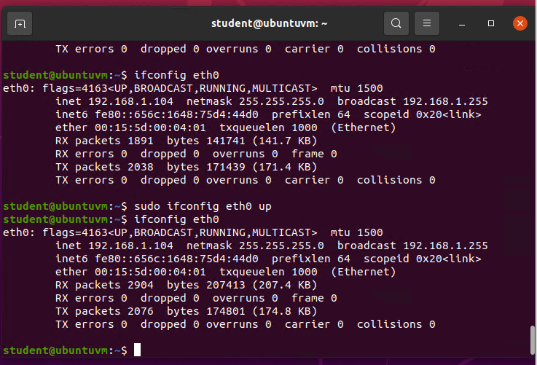
Use network utilities
Take a screenshot of the output in Step 5.

